Slide 1
Android Testing That Doesn’t Suck
github:Rebootd
@computeristco
getting started…

Slide 2


Testing?
Unit Tests?
Integration Tests?
UI Tests?
@computeristco
github:rebootd

Slide 3

Testing?
Helps solving problems
Find bugs faster
Faster development speed
Cleaner code
@computeristco
github:rebootd

Slide 4

Testing?
But I won’t do it if it sucks
Helps solving problems
Find bugs faster
Faster development speed
Cleaner code
@computeristco
github:rebootd

Slide 5
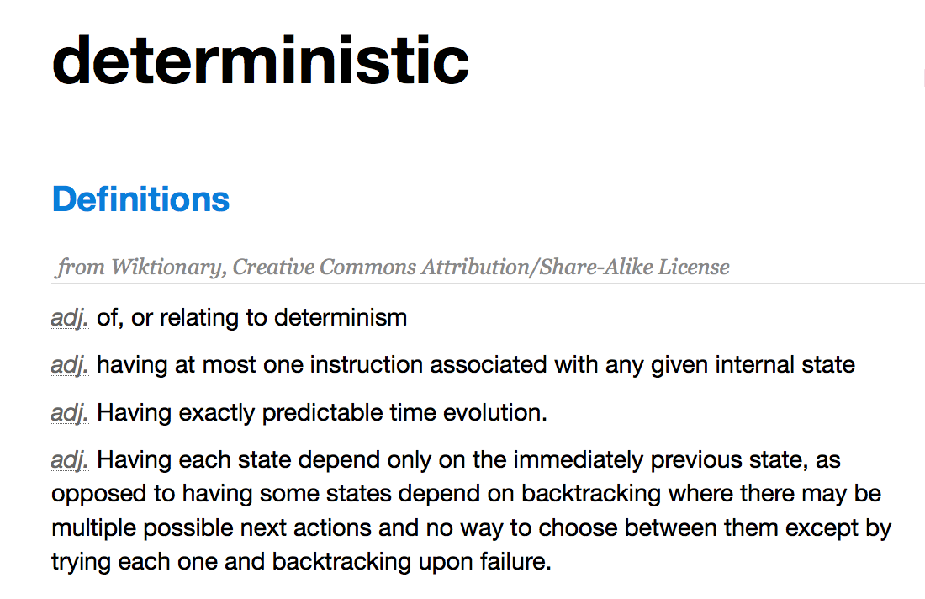
because philosophy…
@computeristco
github:rebootd

Slide 6

Tools
@computeristco
github:rebootd

Slide 7

Tools
jUnit
@computeristco
github:rebootd

Slide 8
Tools
jUnit
Espresso
@computeristco
github:rebootd

Slide 9
Tools
jUnit
Espresso
UIAutomator
@computeristco
github:rebootd

Slide 10
Tools
jUnit
Espresso
UIAutomator
Monkey
@computeristco
github:rebootd

Slide 11
Tools
jUnit
Espresso
UIAutomator
Monkey
Robotium
@computeristco
github:rebootd

Slide 12

Tools
jUnit
Espresso
UIAutomator
Monkey
Robotium
Robolectric
@computeristco
github:rebootd

Slide 13

how do I make it easy
Base classes
Mocking
DI
OSS
Gradle scripts
Build Server
Just say no to “friction burn” image search
@computeristco
github:rebootd

Slide 14
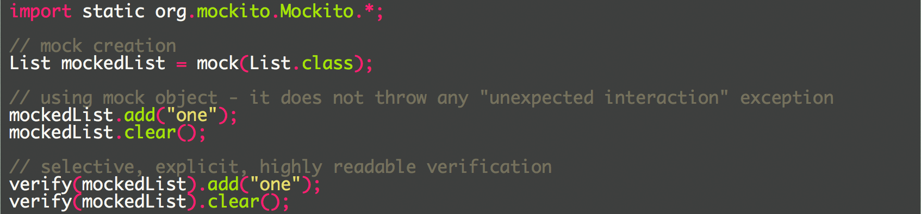
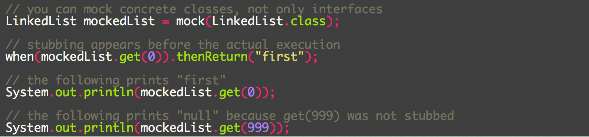
Mocking
@computeristco
github:rebootd

Slide 15
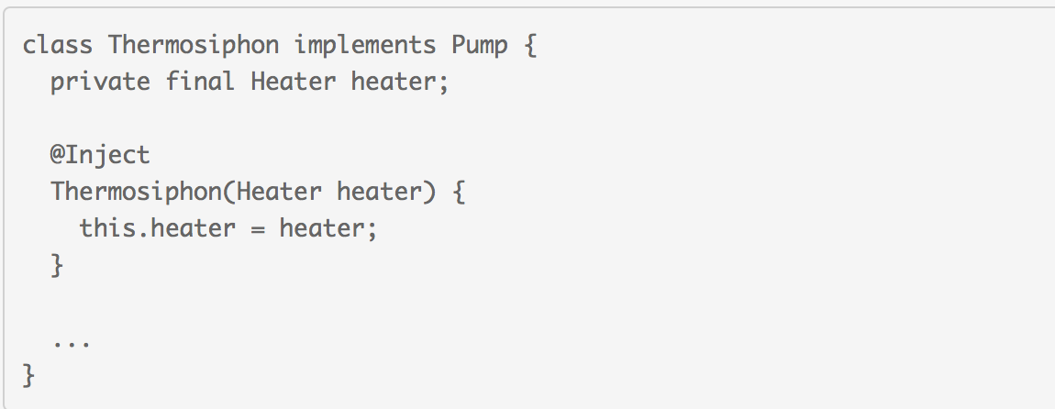
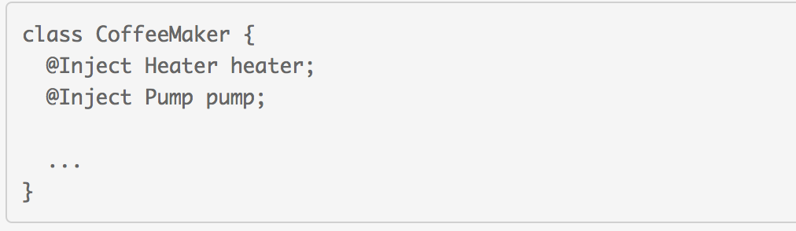
Dependency INjection
Diving Deeper with Dagger - Fragmented Podcast
http://fragmentedpodcast.com/episodes/021/
@computeristco
github:rebootd

Slide 16
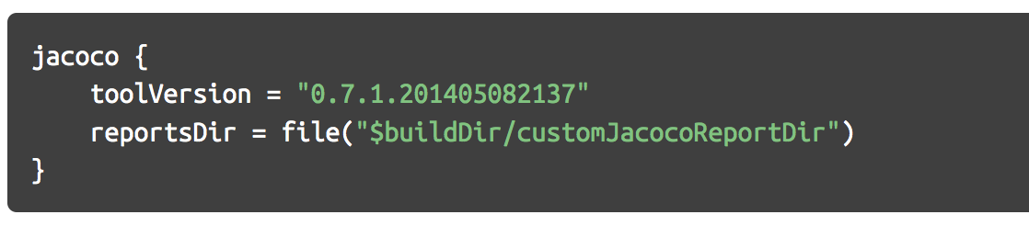
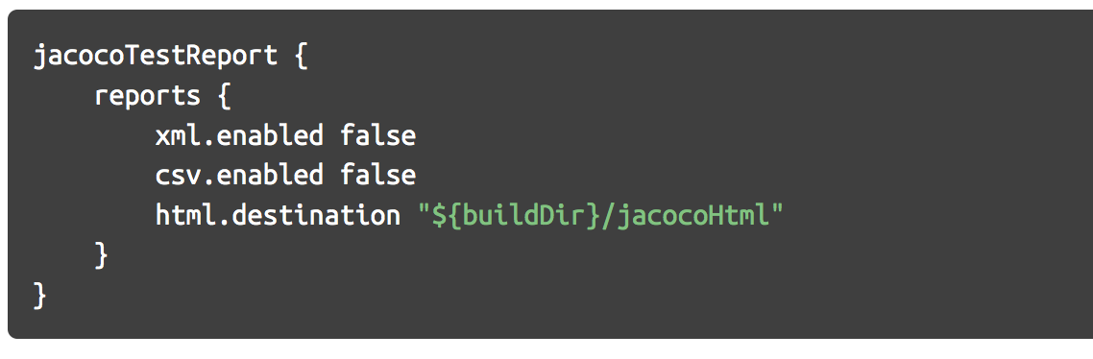
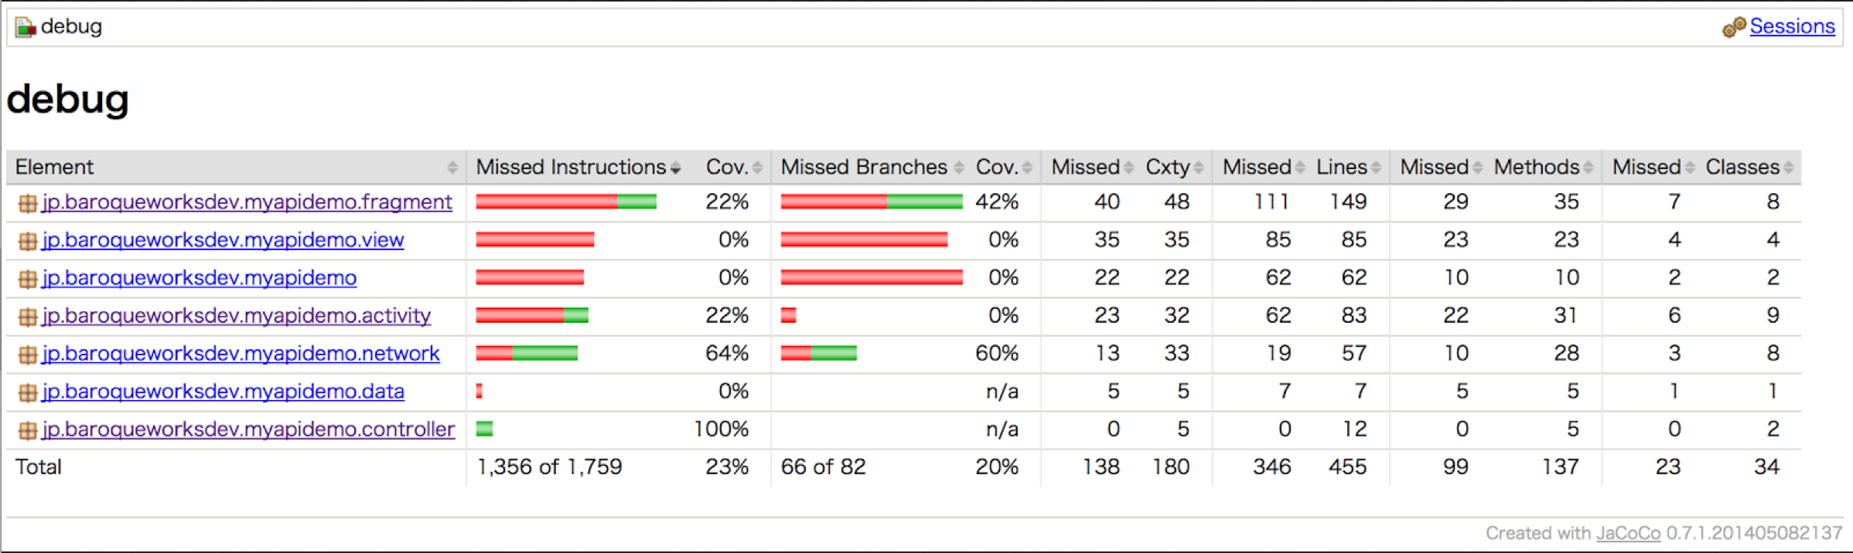
code coverage
JaCoCo: https://docs.gradle.org/current/userguide/jacoco_plugin.html
@computeristco
github:rebootd

Slide 17
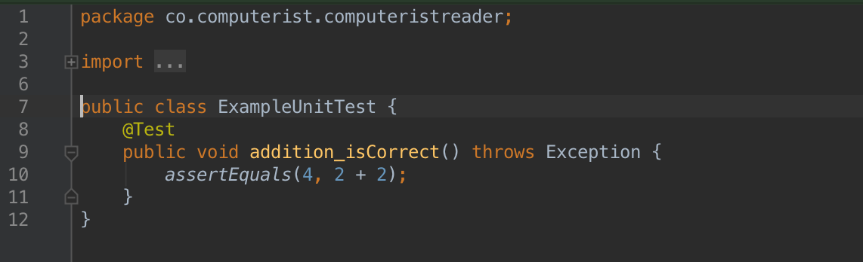
Start writing tests
Keep it really simple at first
Reality Check.
Getting started is the hardest part when you’re the only developer.
Getting buy-in is the hardest part when you work on a team.
Also: If you are getting tired of doing it, so is the team.
@computeristco
github:rebootd

Slide 18
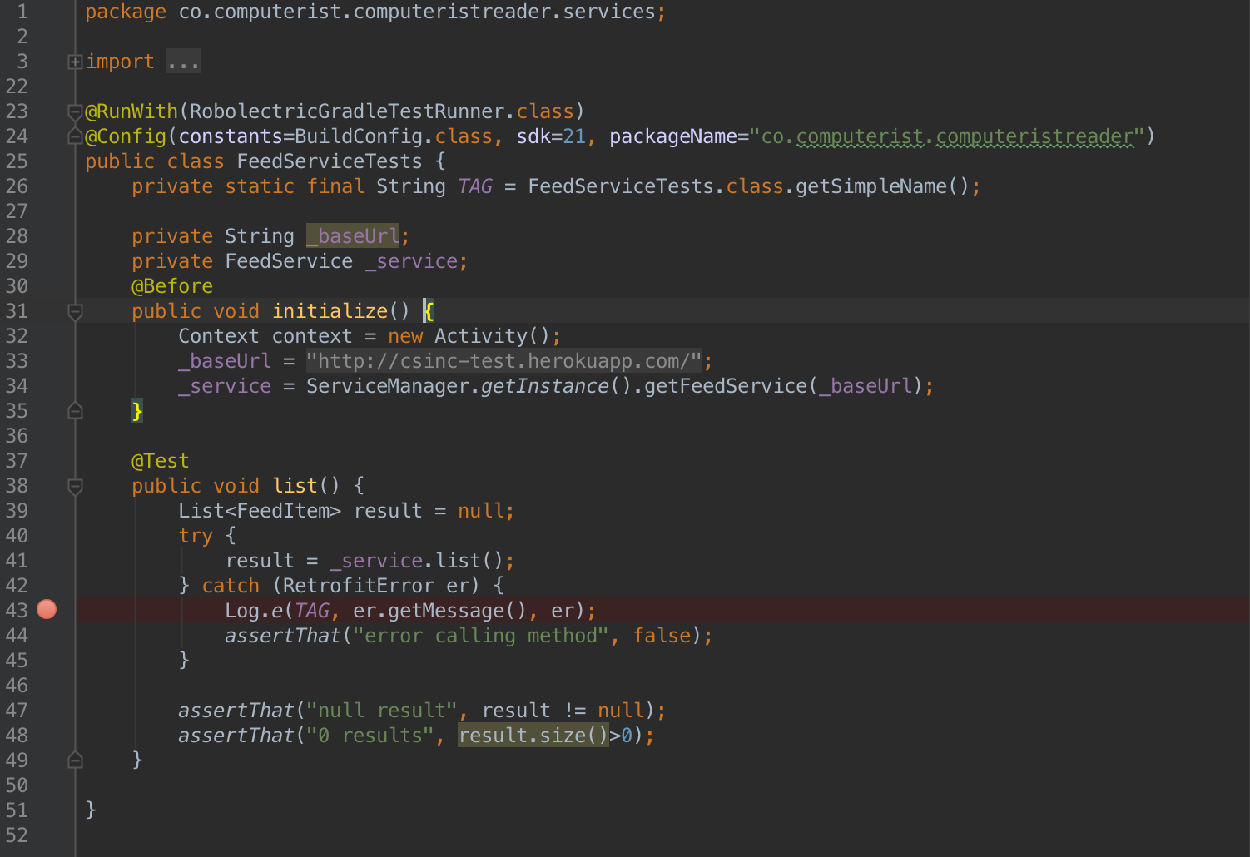
Start writing tests
Then do something more meaningful, but still simple
@computeristco
github:rebootd

Slide 19
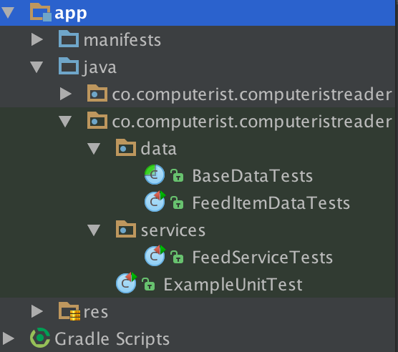
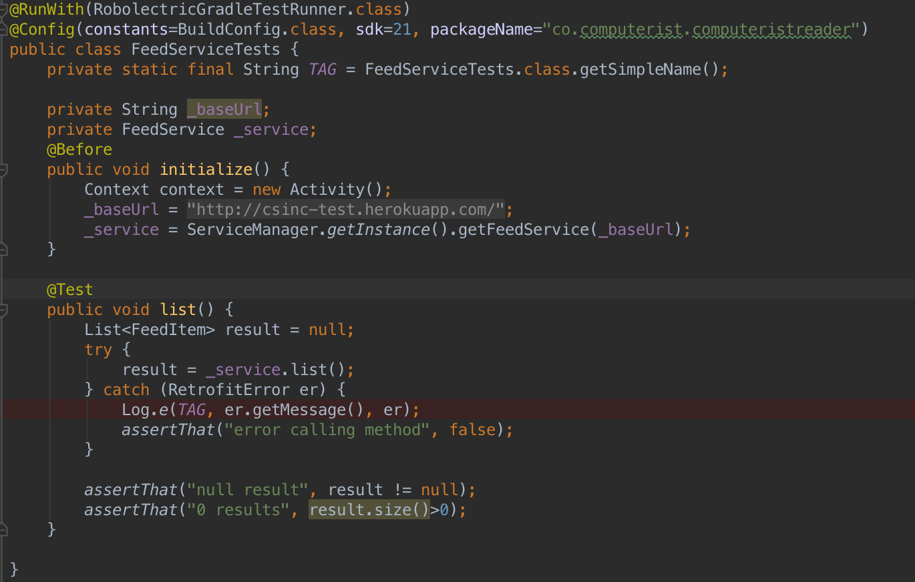
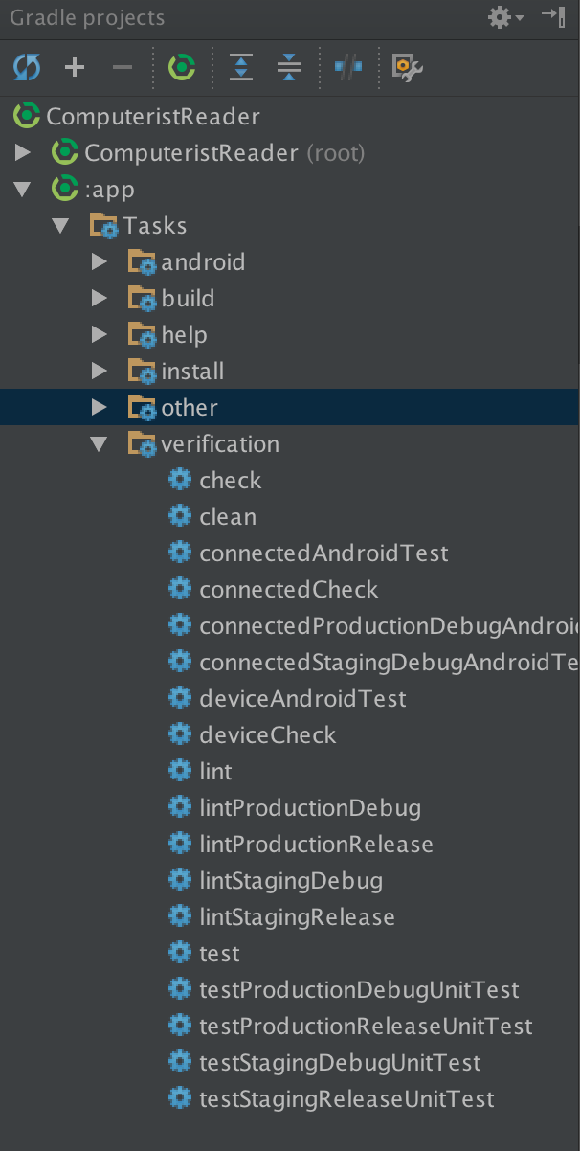
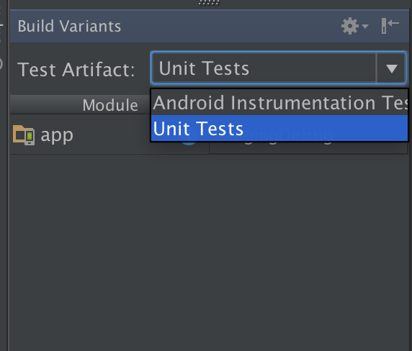
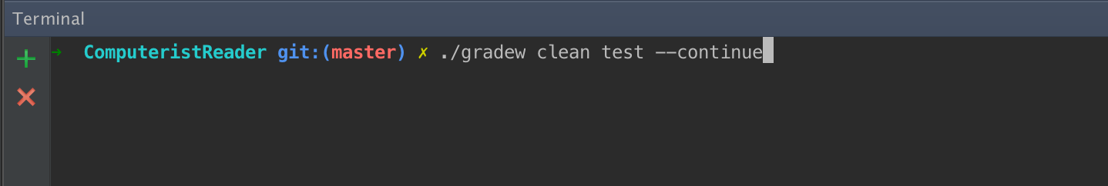
running your tests
@computeristco
github:rebootd

Slide 20
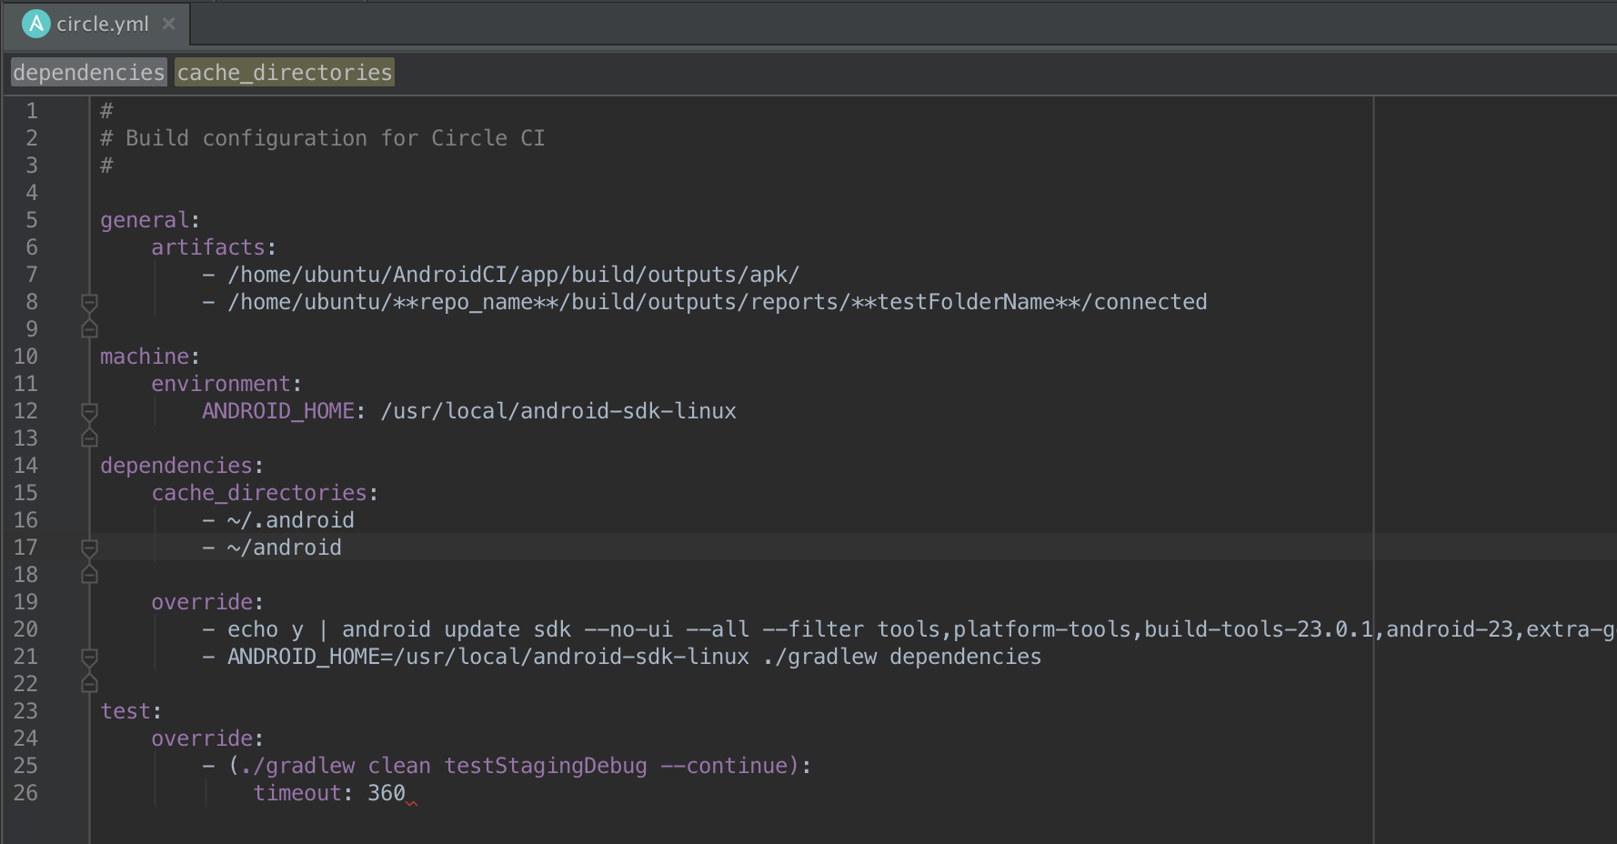
running your tests
@computeristco
github:rebootd

Slide 21
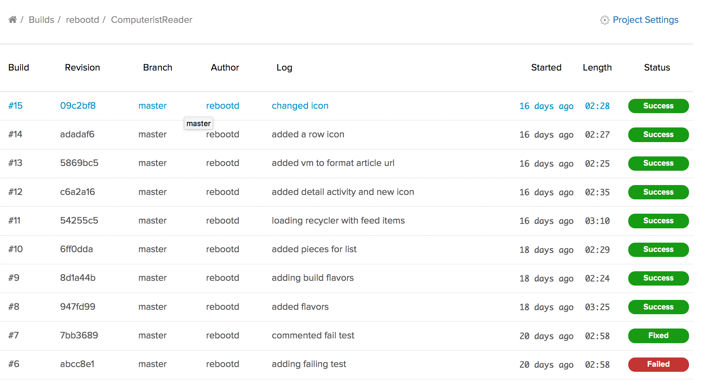
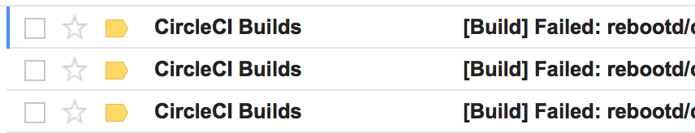
Build server integration
@computeristco
github:rebootd

Slide 22

Watch Out For…
flavors
unsupported api features
slow tests
asynchronous can’t be tested
SSL certificate issue with api calls sometimes
@computeristco
github:rebootd

Slide 23
What else?
UI Testing and build servers?
Appium?
Monkey Runner?
UI Automator?
Ranorex?
Selendroid?
@computeristco
github:rebootd

Slide 24
Links and References
Code:
https://github.com/rebootd/ComputeristReader
GDE’s:
https://github.com/chiuki
https://github.com/donnfelker
Articles & Samples
https://github.com/googlesamples/android-testing
http://www.meetup.com/DenverDroids/events/224537126/
http://blog.sqisland.com/2015/10/how-i-prepared-my-keynote.html
http://www.donnfelker.com/materials-from-hdc09-testing-with-mocks-talk/
http://www.donnfelker.com/integration-testing/
@computeristco
github:rebootd

Slide 25

To be continued…
Resources:
http://slides….
https://github.com/rebootd/ComputeristReader
Contact:
http://computerist.co
https://github.com/rebootd
https://twitter.com/computeristco
Ask me about presenting for your group
@computeristco
github:rebootd

